Slide 1
Big Data Analytics Tool: HBase
Lecture 13
Dr. Kashish Ara Shakil Assistant Professor Department of Computer Science & Engineering,
Jamia Hamdard, New Delhi

Slide 2
HBase: Overview
HBase is a column-oriented database management system that runs on top of Hadoop Distributed File System (HDFS).
It is well suited for sparse data sets, which are common in many big data use cases.
Unlike relational database systems, HBase does not support a structured query language like SQL; in fact, HBase isn’t a relational data store at all.
HBase applications are written in Java much like a typical Apache MapReduce application.
An HBase system comprises a set of tables.
Each table contains rows and columns, much like a traditional database.
Each table must have an element defined as a Primary Key, and all access attempts to HBase tables must use this Primary Key.

Slide 3
HBase allows for many attributes to be grouped together into what are known as column families, such that the elements of a column family are all stored together.
This is different from a row-oriented relational database, where all the columns of a given row are stored together. With HBase you must predefine the table schema and specify the column families.
However, it’s very flexible in that new columns can be added to families at any time, making the schema flexible and therefore able to adapt to changing application requirements.

Slide 4
HBase: Part of Hadoop’s Ecosystem
Data Management
Oozie
(Workflow monitoring
Chukwa (monitoring)
Flume
(monitoring)
Zoo Keeper
(Management)
Data Access
Hive
(SQL)
Pig
(Data Flow)
Mahout
(Machine Learning)
Avro
(RPC, Serialization)
Sqoop
(RDBMS Connector)
MapReduce
(Cluster Management)
YARN
(Cluster & Resource Management)
Data Processing
HDFS
(Distributed file system)
HBase
(Column DB storage)
Data storage
Ref[14]

Slide 5
HBase Use Cases
HBase has a market share of about 7.5% for example, approximately 6190 companies are using HBase. The industries are using HBase for time series analysis or for click stream data storage and analysis.
Original HBase was used at Google which wanted to store massive databases for the internet and its users.
Ref[7]

Slide 6
Continued
Facebook is using HBase for real-time analytics, counting Facebook likes and for messaging.
FINRA Financial Industry Regulatory Authority using HBase to store all the trading graphs.
Pinterest is using HBase to store the graph data.
Flipboard is using HBase to personalize the content feed for its users.

Slide 7
Top Companies use Apache HBase
Industry | Number of companies
Computer Software | 2306
Information Technology and Services | 917
Staffing and Recruiting | 484
Higher Education | 190
Financial Services | 189
Management Consulting | 180
Internet | 155
Hospital & Health Care | 153
Telecommunications | 128
Insurance | 114
Source of Data: https://idatalabs.com/tech/products/apache-hbase

Slide 8
The percentage sharing of companies who is
using HBase

Slide 9
Country Wise Companies use Apache HBase
Country | Number of companies
United States | 4296
India | 553
United Kingdom | 467
Canada | 248
France | 157
Germany | 103
Australia | 98
China | 76
Spain | 64
Netherlands | 54
Source of Data: https://idatalabs.com/tech/products/apache-hbase

Slide 10
Difference between Hive and HBase
Hive | HBase
Hive is query engine | HBase is a data storage particularly for unstructured data.
Apache Hive is mainly used for batch processing i.e. OLAP | HBase is extensively used for transactional processing wherein the response time of the query is not highly interactive i.e. OLTP.
Hive is to analytical queries. | HBase is to real-time querying
Ref[7]

Slide 11
Hive and HBase –Better Together
There is some limitations with Hive of high latency and HBase does not have analytical capabilities
Integrating Hive and Hbase Technologies together is the preeminent solution.
People working with big data have this question in their mind on –“How to use HBase from Hive?
How well does hive and HBase work together and what is the preeminent way to use them?
Ref[7]

Slide 12
Continued
Usually HBase and Hive are used together on the same Hadoop cluster.
Hive can be used as an ETL tool for batch inserts into HBase or to execute queries that join data existing in HBase tables with the data existing in HDFS files or in external data stores.

Slide 13
Why use the HBase technology?
HBase is one of the core Hadoop components of the ecosystem and other two HDFS and MapReduce. It is part of the Hortonworks Data Platform Apache Hadoop ecosystem which is available as a highly secure, enterprise ready big data framework. It is being frequently deployed by some of the biggest industries like Facebook messaging system and as many.
Ref[8]

Slide 14
Continued
There are some of the salient features of HBase is as follows:
It has a entirely distributed architecture and can work on extremely huge scale data.
It works for extremely random R/W operations
It has high security and easy Data management.
It provides an unprecedented high write throughput
Scaling to meet additional requirements is seamless and quick

Slide 15
It can be used for both structured and semi-structured data.
It is good when you don’t requirement of full RDBMS capabilities.
Hbase has a perfectly modular and linear scalability feature.
The data R/W are strictly consistent.
The table sharding can be easily configured and automatized.
The several servers are provided automatic failover support.
The MapReduce tasks can be backed with HBase Tables.

Slide 16
What is the scope of Apache HBase?
One of the most important HBase, it can handle data sets which number in billions of rows and millions of columns.
It can extremely well combine the many data sources that are coming from a extensive diversity of types, structures and schemas.
It can be integrated natively with Hadoop in order to provide a seamless fit is the best part. It also works very well with YARN. HBase gives very low latency access over fast-changing and huge amounts of data.
Ref[8]

Slide 17
Why need this technology and what is the problem that it is solving?
HBase is a very progressive NoSQL database that is sighted increased usage in present today which is overwhelmed with Big Data.
It has a very simple Java programming roots that can be deployed for scaling HBase on a big scale.
Ref[8]

Slide 18
There are a lot of commercial scenarios wherein you are exclusively working with sparse data that is to look for a handful of data fields matching a certain criteria within data fields which are in the billions.
It is extremely fault-tolerant and resilient and can work on multiple data type making it useful for varied commercial scenarios.

Slide 19
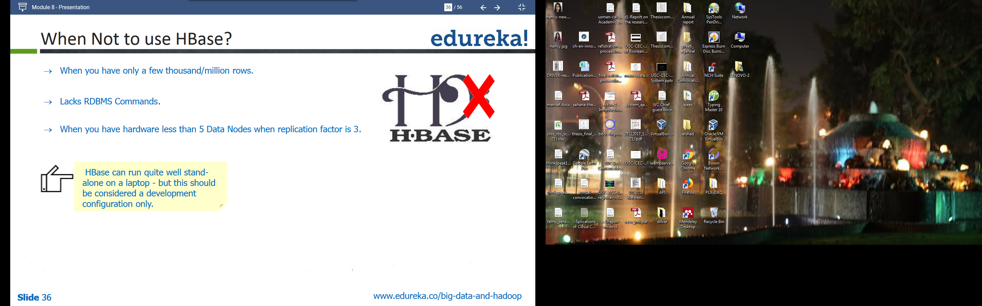
When not Use HBase
When you have only few thousand/
million rows
Lacks Command of RDBMS
When you have hardware less than
5 data Nodes when replication factor
is 3
But HBase can run quit well standalone on a laptop-but this should be considered a development configuration

Slide 20
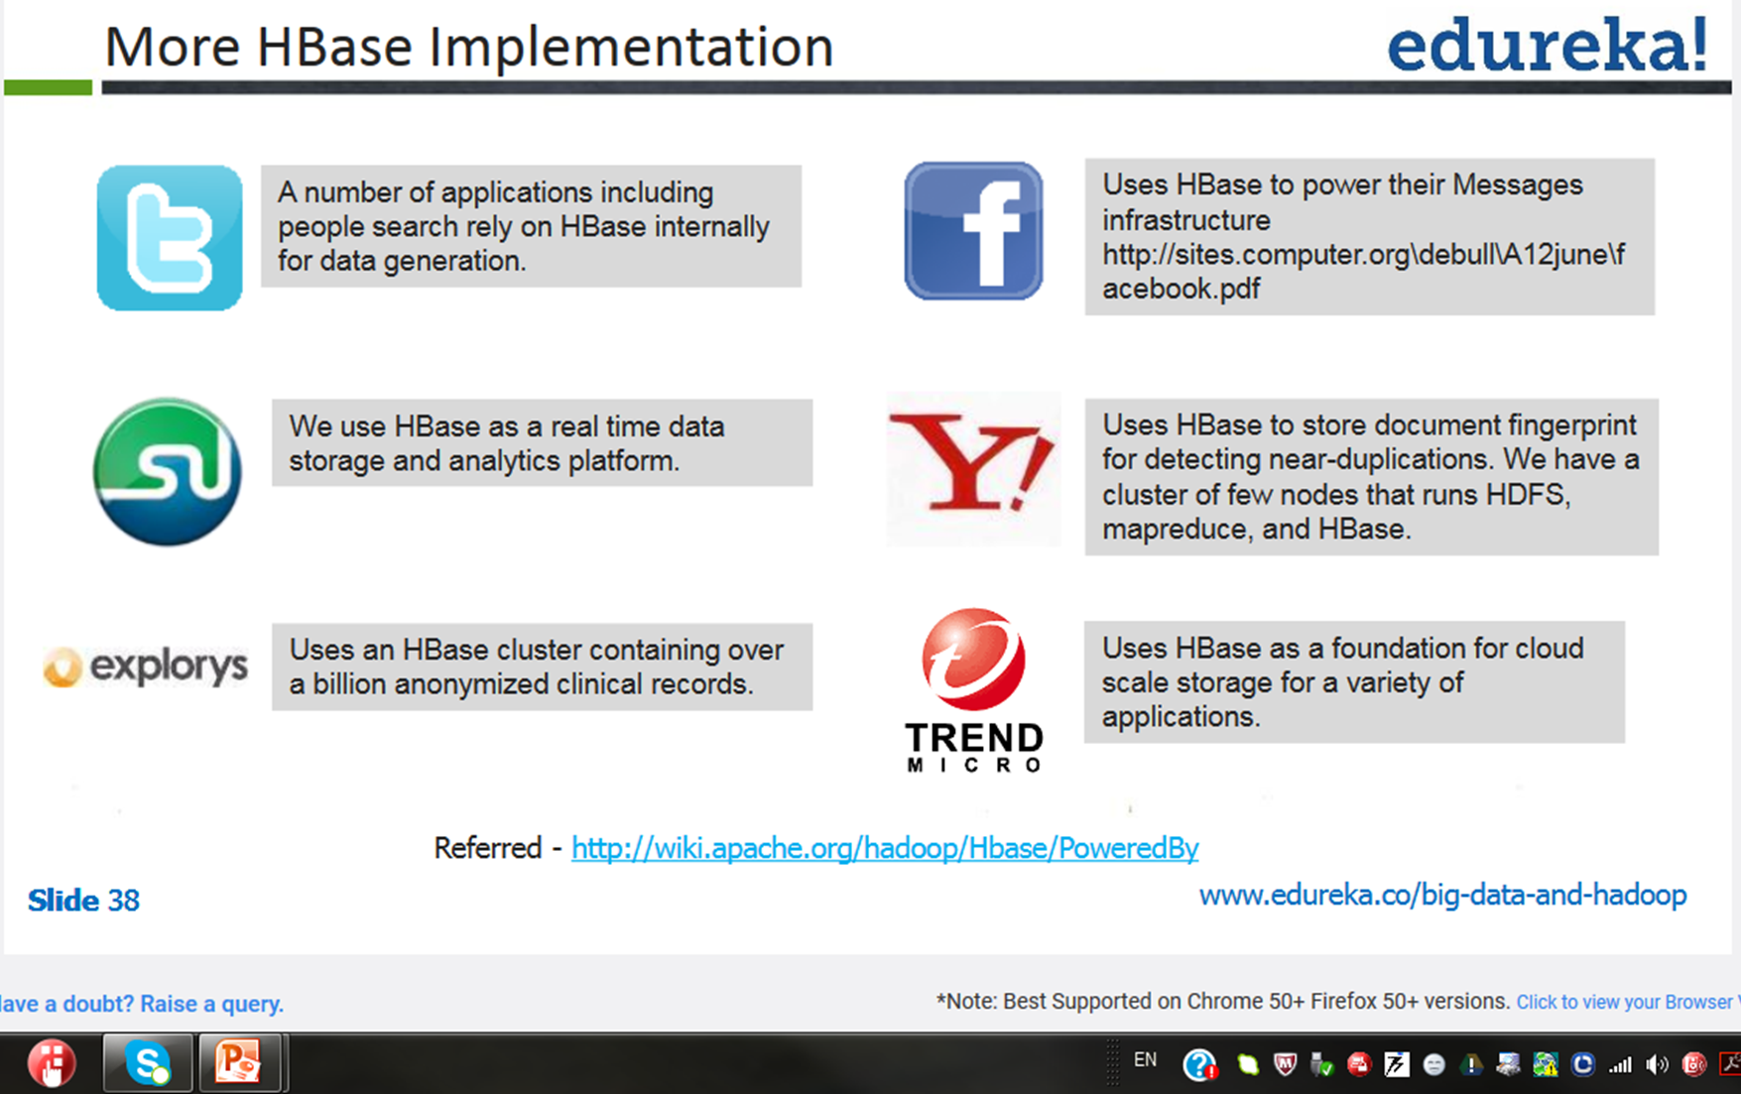
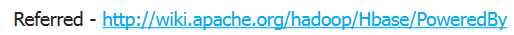
HBase Implementation
A number of applications including people search rely on HBase internally for data generation
Uses of HBase to power their Messages infrastructure
We use HBase as a real time data storage and analytics platform

Slide 21
Continued
Uses HBase to store document fingerprint for detecting near-duplications. We have a cluster of few nodes that run HDFS, MapReduce, and HBase
Uses an HBase cluster containing over a billion anonymized clinical records
Uses HBase as a foundation for cloud scale storage for a variety of applications

Slide 22
HBase Architecture
Zookeeper
Register Hmaster location
and –Root- location
Lookup Master
Client rarely needs HMaster
HMaster
Client
Assign regions to RegionServers,
Check health of RegionServer
R/W Data
TableFoo
TableBar
TableFoo
TableBar
MemStore(CF1)
MemStore
(CF1)
MemStore(CF1)
MemStore
(CF1)
Region
Region
Region
Region
MemStore(CF2)
MemStore(CF2)
-Root-
META
MemStore(CF1)
MemStore(CF1)
RegionServer1
RegionServer2
Region
Region
HLog
HLog
Ref[8]
Ref[8]

Slide 23
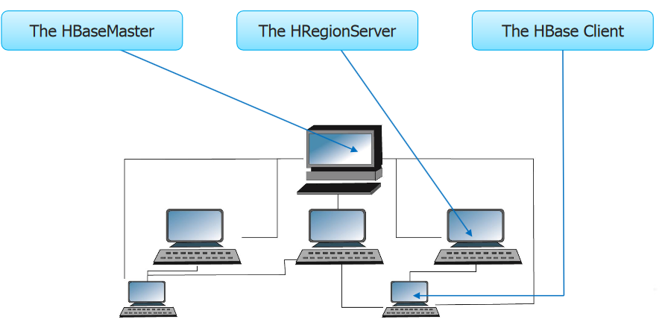
Major Components of HBase
There are three major components of HBase are given in
the following diagram

Slide 24
HBaseMaster
HBase Master coordinates the HBase Cluster and is responsible for administrative operations.
A Region Server can serve one or more Regions.
Each Region is assigned to a Region Server on startup and the master can decide to move a Region from one Region Server to another as the result of a load balance operation.
The Master also handles Region Server failures by assigning the region to another Region Server.
Ref[10]

Slide 25
HRegionServer
HRegionServer makes a set of HRegions available to clients.
It checks in with the HMaster. There are many HRegionServers in a single HBase deployment.
HMaster- Region Assignment and Balancing
Ref[11]

Slide 26
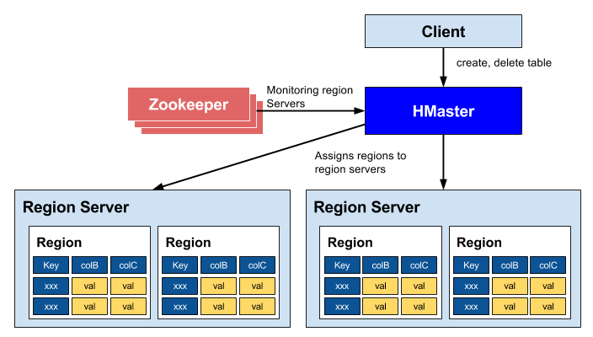
Ref[12]

Slide 27
Architectural differences between RDBMS and HBase
Relational Databases | HBase
Uses tables as databases | Uses regions as databases
File system supported are FAT, NTFS and EXT | File System supported is HDFS
The Technique used to store logs is commit logs | The technique used to store logs is Write-Ahead Logs(WAL)
Ref[13]

Slide 28
Continued
Relational Databases | HBase
The reference System used is coordinate system | The reference system used is Zookeeper
Uses the primary key | Uses the row key
Partitioning is supported | Sharding is supported
Use of rows, column, and cell | Use of rows, column families, column, and cells

Slide 29
Comparing HBase with Hadoop
HADOOP/HDFS | HBase
This provide file system for distributed storage | This provide tabular column-oriented data storage
This is optimized for storage of huge-sized files with no random r/w of these files | This is optimized for tabular data with random r/w facility
This uses flat files | This uses key-value pairs of data
Ref[13]

Slide 30
Continued
HADOOP/HDFS | HBase
The data model is not flexible | Provides flexible data model
This uses file system and processing framework | This uses tabular storage with built-in Hadoop MapReduce support
This is mostly optimized for write-once read-many | This optimized for both R/W many

Slide 31
Features of HBase
Automatic failover and load balancing: The failover is assisted using RegionServer replication
Automatic sharding: An HBase table is made up of regions which are accommodated by RegionServers and these regions are distributed through RegionServers on dissimilar DataNodes. HBase make available automatic and manual splitting of these regions to smaller subregions, once it reaches a threshold size to reduce I/O time and overhead.
Ref[13]

Slide 32
Continued
Linear scalability (scale out): HBase Scaling is not scale up but scale out, that means , we do not need to make servers more powerful but we add additional machines to its cluster. We can add additional nodes to the cluster on the fly. As soon as a new RegionServer node is up, the cluster can begin re-balancing, start the RegionServer on the new node, and it is scaled up, it is as simple as that.

Slide 33
Continued
Column-oriented: HBase stores individual column separately in contrast with most of the relational databases that uses stores or are row-based storage. Therefore in HBase, columns are stored contiguously and not the rows.
HBase shell support: HBase make available a command-line tool to interact with HBase and perform operations.

Slide 34
Continued
Sparse, multidimensional, sorted map database
Snapshot support: HBase supports captivating snapshots of metadata for getting the previous or data correct state form.

Slide 35
References
https://www.tutorialspoint.com/hive/hive_introduction.htm
https://data-flair.training/blogs/apache-hive-architecture/
https://mapr.com/products/product-overview/apache-hive/
https://www.edureka.co/blog/hive-data-models/
https://www.dezyre.com/hadoop-course/hive
https://www.quora.com/What-are-the-advantages-of-Apache-Hive
https://www.dezyre.com/article/hive-vs-hbase-different-technologies-that-work-better-together/322
https://intellipaat.com/blog/what-is-apache-hbase/
https://www.slideshare.net/martyhall/hadoop-tutorial-hbase-part-1-overview
https://blogs.apache.org/hbase/entry/hbase_who_needs_a_master
https://www.cloudera.com/documentation/other/shared/CDH5-Beta-2-RNs/hbase_jdiff_report-p-cdh4.5-c-cdh5b2/cdh5b2/org/apache/hadoop/hbase/regionserver/HRegionServer.html
https://yeopoong.github.io/dev/2018/03/06/hbase/
http://www.hadoopinsight.com/blog/hbase/understanding-hbase-ecosystem/
https://savvycomsoftware.com/what-you-need-to-know-about-hadoop-and-its-ecosystem/

Slide 36
Thank you

